Slide 1

Chapter 12-s13
How to working with Tables
Notes:
Session: Ghi số thứ tự session trong môn học
Session Name: ghi tên của session sẽ dạy

Slide 2
Objectives
Basic HTML skills for coding tables
Basic CSS skills for formatting tables
Other skills for working with tables
Notes:
Mô tả nội dung mà học viên phải đạt được khi kết thúc môn học này

Slide 3
Basic HTML skills for coding tables

Slide 4
An introduction to tables
A table consists of rows and columns that intersect at cells
Cells that contain the data of the table are called data cells
Cells that identify the data in a column or row are called header cells
The header for a table can consist of more than one row, and the footer for a table can consist of more than one row
The body of a table, which contain data

Slide 5
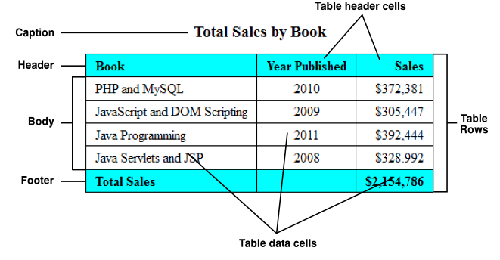
A simple table
A simple table with basic formatting

Slide 6
How to create a table?
The width of each column in a table is determined automatically based on its contents
The content of a th elements is boldfaced and centered and the content of a td element is left-aligned

Slide 7
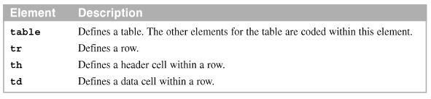
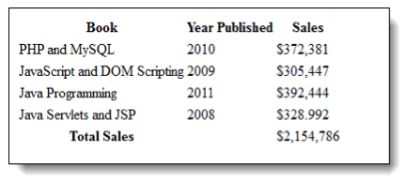
Common elements for coding tables
Common elements for coding tables
The table in a web browser with no CSS formatting

Slide 8
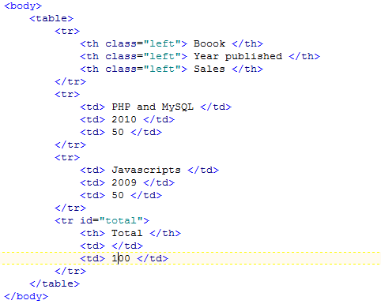
An example table

Slide 9
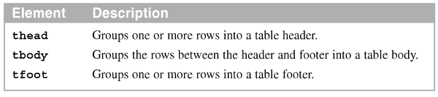
How to add a header and footer
The thead, tbody, and tfoot elements make it easier to style a table with CSS
The elements for coding the header, body, and footer

Slide 10
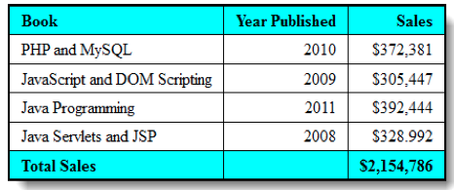
The table in a web browser

Slide 11
Basic CSS skills for formatting tables

Slide 12
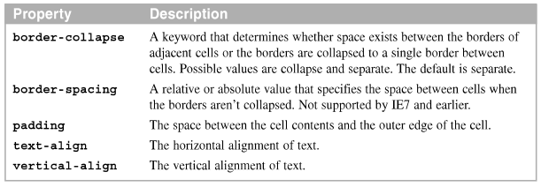
How to use CSS to format a table
Common properties for formatting table, tr, th, and td elements

Slide 13
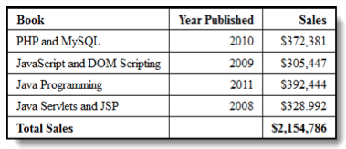
An example table
The table in a web browser

Slide 14
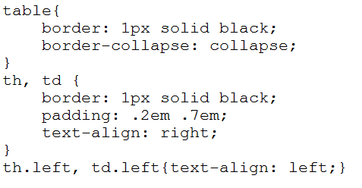
An example table

Slide 15

The table in a web browser

Slide 16
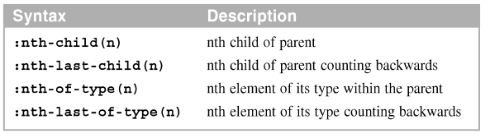
The CSS3 structural pseudo-classes for formatting tables
The syntax for the CSS3 structural pseudo-class selectors

Slide 17
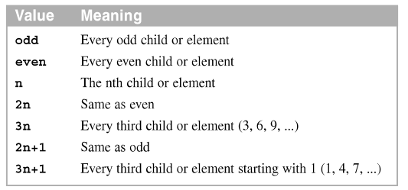
Typical n values

Slide 18
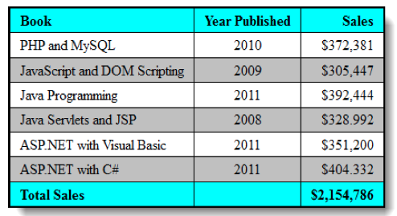
Table in a browser

Slide 19
Other skills for working with tables

Slide 20
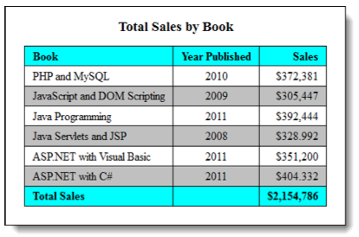
The HTML5 figure and figcaption elements with tables
A table within a figure

Slide 21
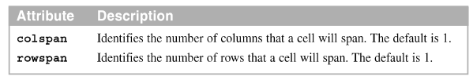
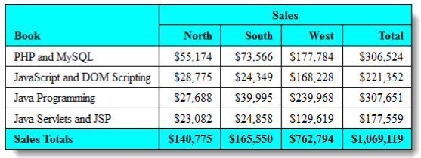

How to merge cells in a column and row
Attributes of the <th> and <td> tags for merging cells
A table with merged cells

Slide 22
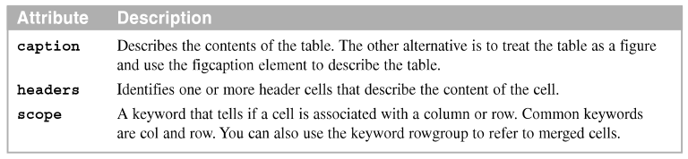
How to provide for accessibility
Use the attributes listed above to make a table more accessible to visually-impaired users who use screen readers
Attributes that can be used for accessibility

Slide 23
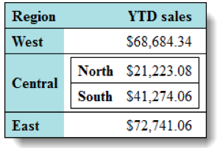
How to nest tables
Can nest table within another table by coding a table element within a td element
Nested tables were used frequently when tables were for page layout.
A table with another table nested within one of its cells

Slide 24
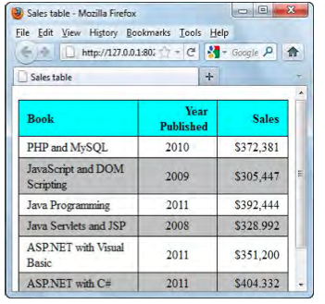
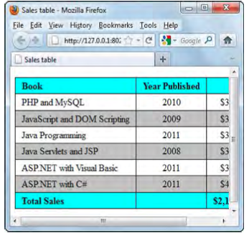
How to control wrapping
Use the white-space property to keep table data from wrapping.
A table with wrapping A table without wrapping
The property that stops wrapping
table { white-space: nowrap; }

Slide 25
Summary
A table consists of rows and columns that intersect at cells
Merge two or more cells in a column or row
The browser will wrap the data

